Slide 1
Model-Based Verification & Validation: Gaining confidence in your design
30 April 2019
Chuck Olosky Application Engineer
Shaun Kalinowski Application Engineering Manager
Yoke Peng Leong Application Engineer

Slide 2
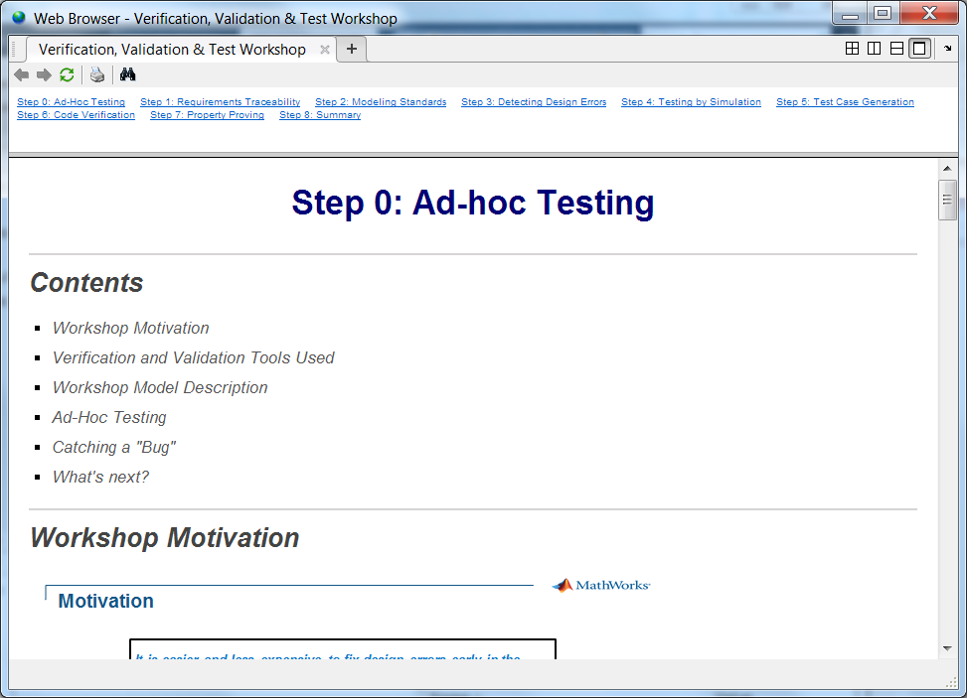
Extract & Open V&V Workshop Project
Copy zip file
Create directory for extraction
Extract contents “to here”
Open MATLAB R2018b
Navigate to extraction directory
Open “VnV_Wkshp.prj”
HTML instructions will appear

Slide 3
Motivation
It is easier and less expensive to fix design errors early in the process when they happen.
We will talk about ….
How Model Based Design (MBD) facilitates early testing to incrementally increase confidence in your design
Usage of V&V tools to enable delivery of higher quality software throughout the workflow
Integration of V&V testing with code generation to improve confidence in the work product

Slide 4
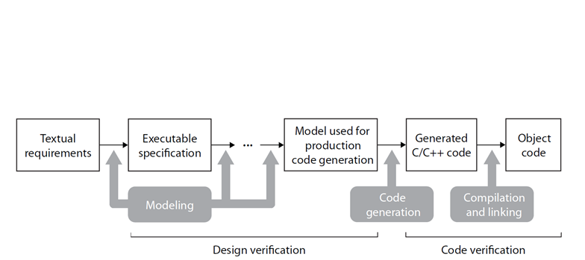
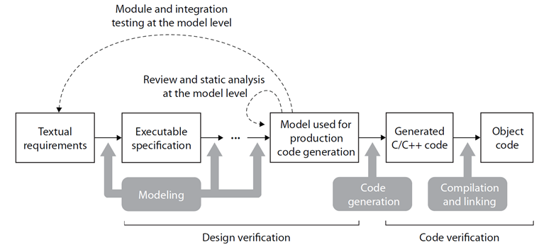
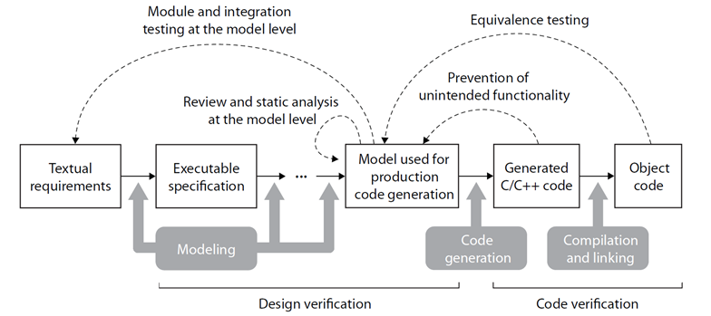
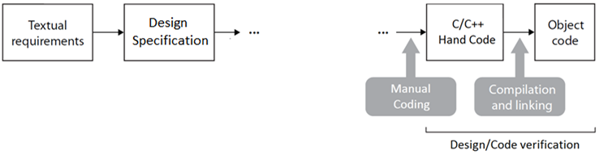
Model Based Design Verification Workflow
Model Verification
Code Verification
Discover design errors at design time
Gain confidence in the generated code

Slide 5

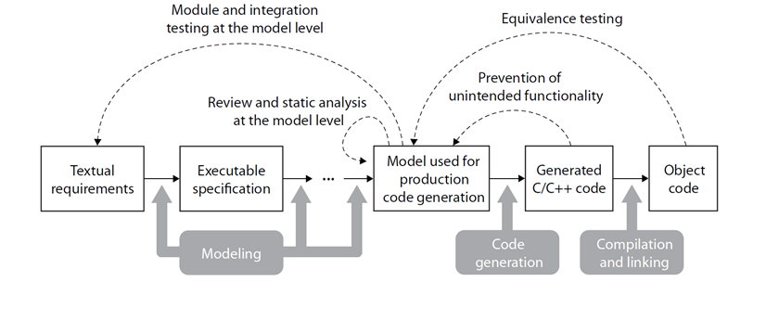
Model Verification Tools
Early Ad-hoc Testing
Simulink
Trace to Requirements
SL Reqs
Model Advisor Checks
SL Check
Design Error Detection
SLDV
Testing by Simulation with Model Coverage
SL Test
SL Coverage
Property Proving
SLDV
Model Verification
Discover design errors at design time
Pressing play (Simulink)
Requirements linking/reporting (SL Reqs)
Test harness creation (SL Test)
Test execution/reporting (SL Test)*
Measure test case coverage on model (SL Cov)*
Modeling standards compliance (SL Check)*
Finding dead logic, divide by zero (SLDV)
Prove model behavior compliance (SLDV)
Simulink, Stateflow, Simulink Fixed Point
*Cert Kit Pre-qualified Tool Use Cases

Slide 6
Code Generation & Verification Tools
Code Verification
Gain confidence in the generated code
Traceability Report
SL Reqs
Embedded Coder
Generating Test Vectors
SLDV
Model/Code Equivalence
Simulink (SIL/PIL)
Embedded Coder
SL Test
Code Coverage (SL Cov)
Trace code to model and requirements (Embedded Coder, SL Reqs)
Measure test coverage on code (SL Cov)*
Generate 100% coverage test vectors (SLDV)*
SIL/PIL testing / CGV (Embedded Coder)
Test exec (reuse model testing assets) (SL Test)*
*Cert Kit Pre-qualified Tool Use Cases
Code Generation Embedded Coder*

Slide 7
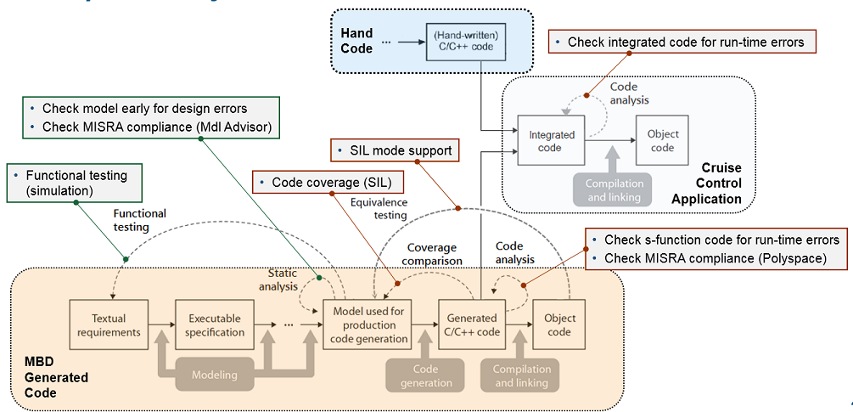
Unified Model and Code Verification Workflow

Slide 8
V&V Workshop Agenda – Day 1
Introduction and 9:00-9:15
MBD V&V Overview
Ad-hoc Testing 9:15-9:30
Performing informal functional checks
Instrumenting the model
Requirements Traceability 9:30-10:00
Linking requirements to Simulink model objects
Generating a requirement traceability report
Modeling Standards 10:00-10:30
Performing static analysis using Model Advisor
Customizing Model Advisor
Break 10:30-10:45
Detecting Design Errors 10:45-11:15
Analyzing the model for unreachable logic
Finding divide by zero issues
Testing by Simulation 11:15-12:45
Creating and using test harness models
Entering input and expected output test vectors
Collecting model coverage from functional test cases
Generating test report
Summary – Q&A Discussion 12:45-13:00

Slide 9
V&V Workshop Agenda – Day 2
Introduction and 9:00-9:15
Day 1 Summary
Test Case Generation 9:15-9:50
Generating test cases for missing model coverage
Merging generated test cases with existing test cases
Code Verification 9:50-10:20
Using the code generation report for traceability
Performing equivalency tests with SIL mode
Collecting code coverage in SIL mode (optional)
Break 10:20-10:30
Property Proving 10:30-11:15
Modeling requirements as properties
Performing property proving to verify requirements
Summary – Q&A Discussion 11:15-11:30

Slide 10
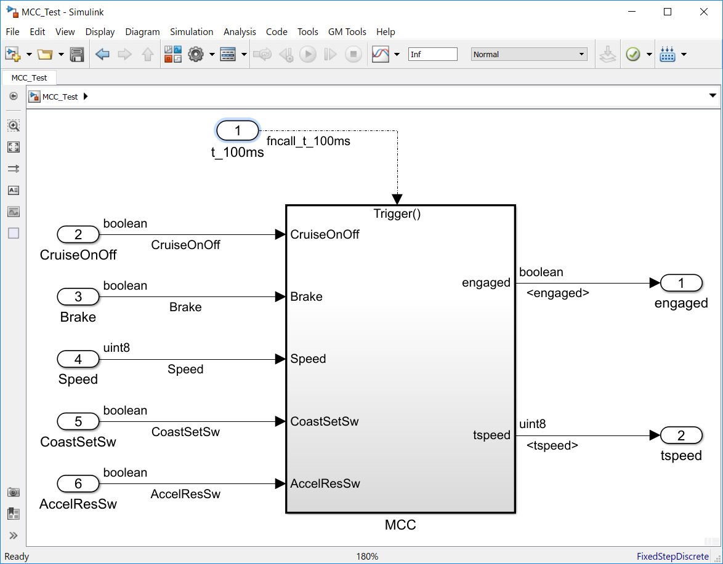
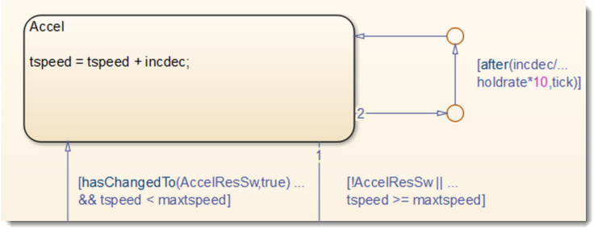
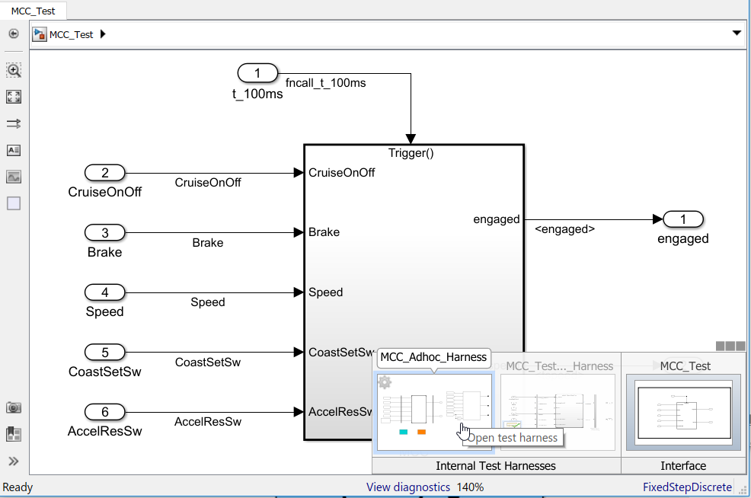
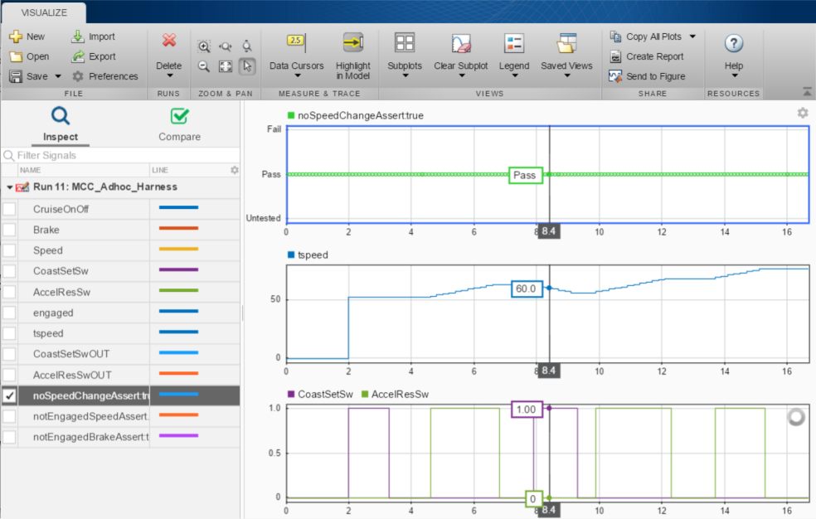
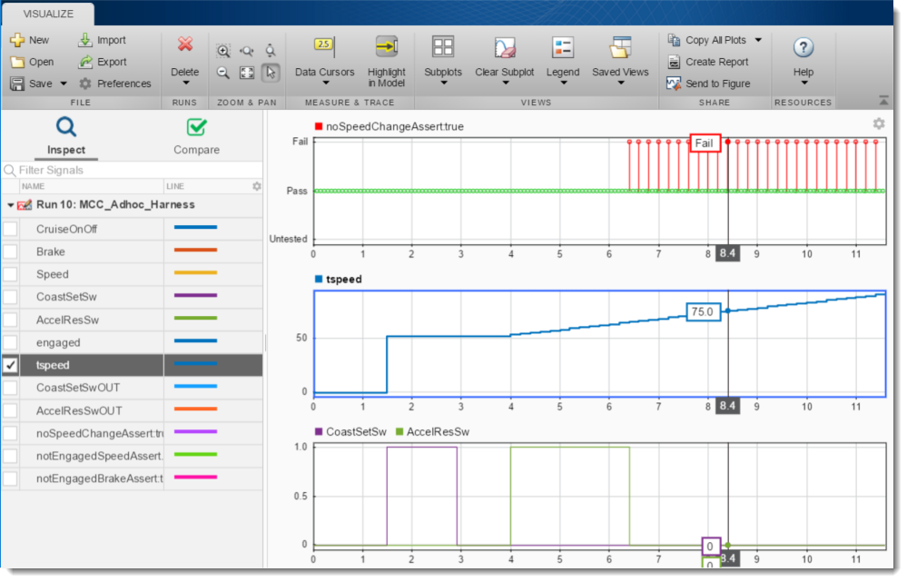
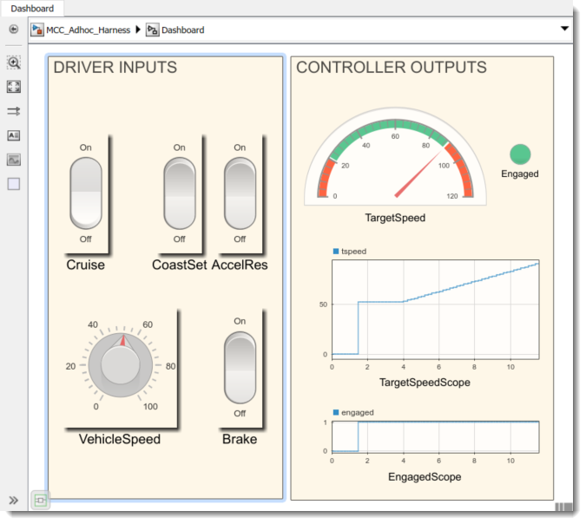
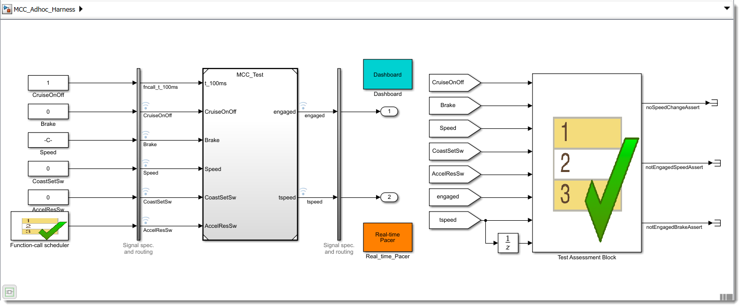
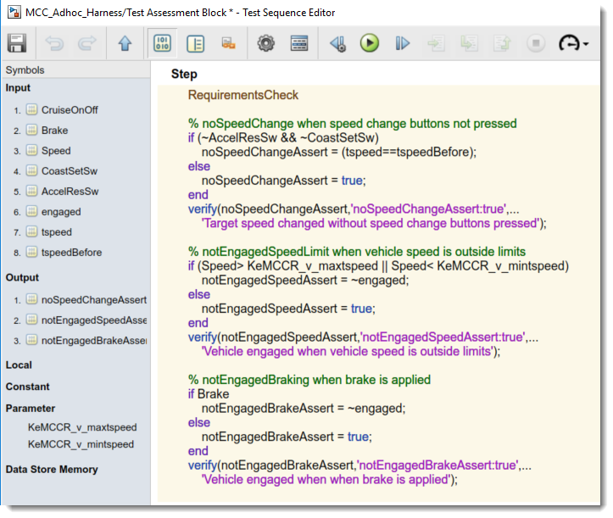
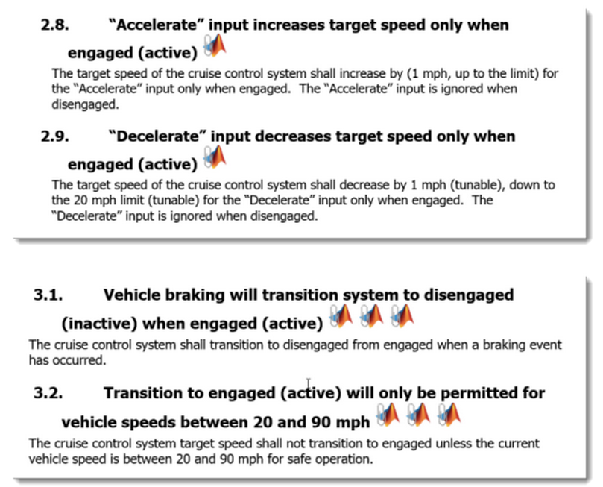
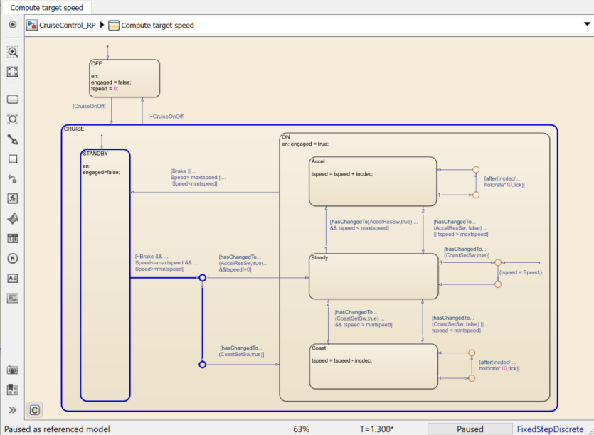
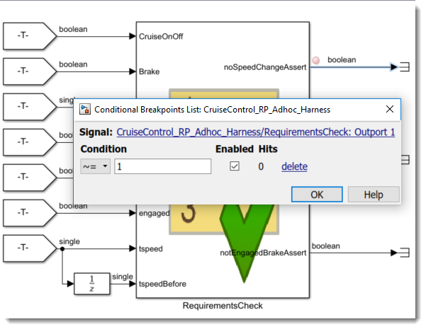
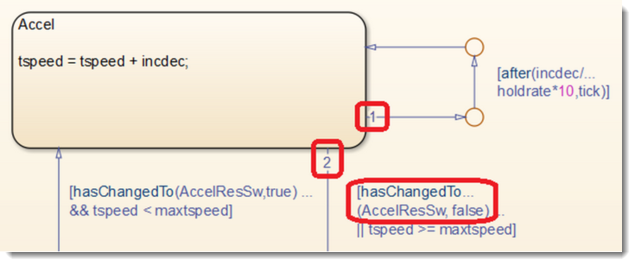
Early Ad-hoc (Interactive) Testing with Simulink Test
Use a harness to support Ad-hoc testing
Verify required behavior with Test Assessment Blocks
Build a user interface panel with Dashboard Blocks
Debug with Simulation Data Inspector and model breakpoints
Simulink Test supports early ad-hoc testing with interactive test harness creation and online test assessments.
Notes:
Range of calibration constraints

Slide 11
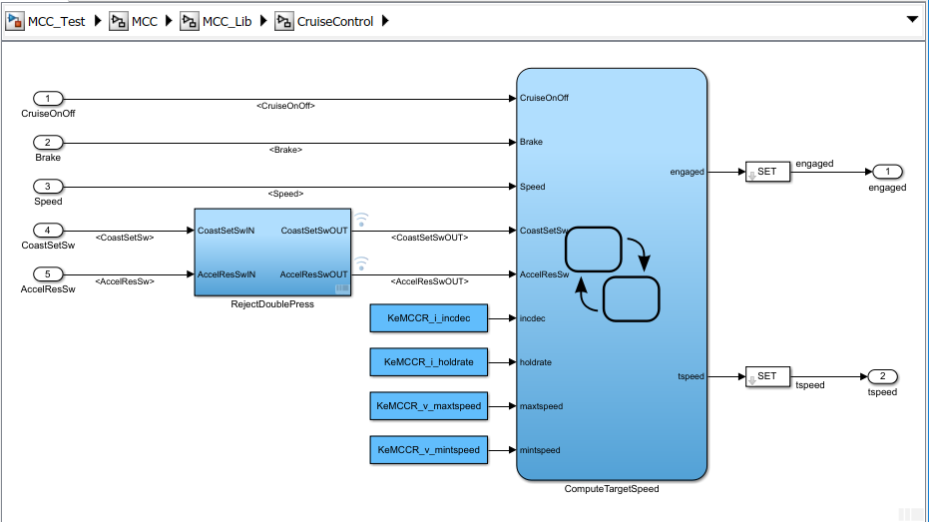
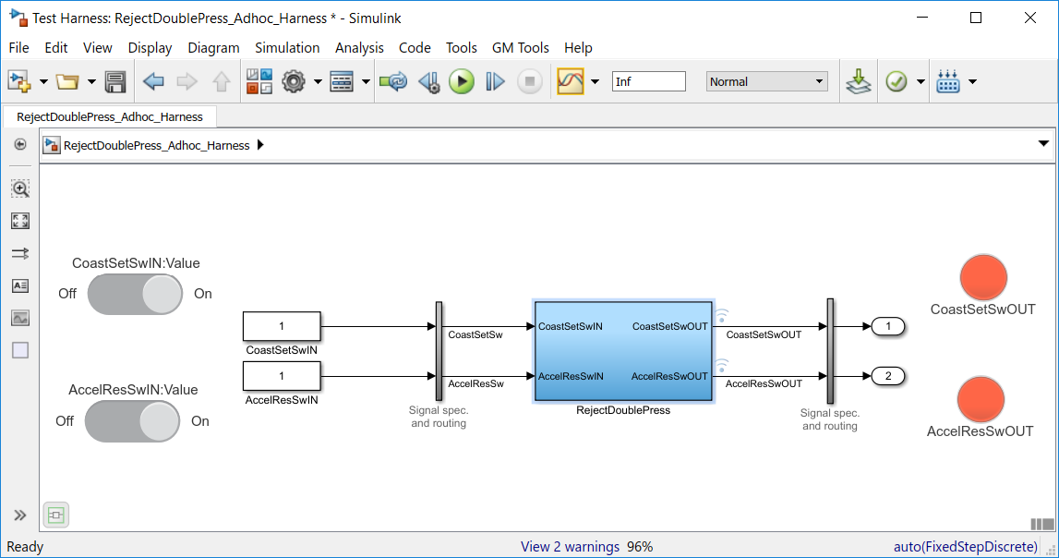
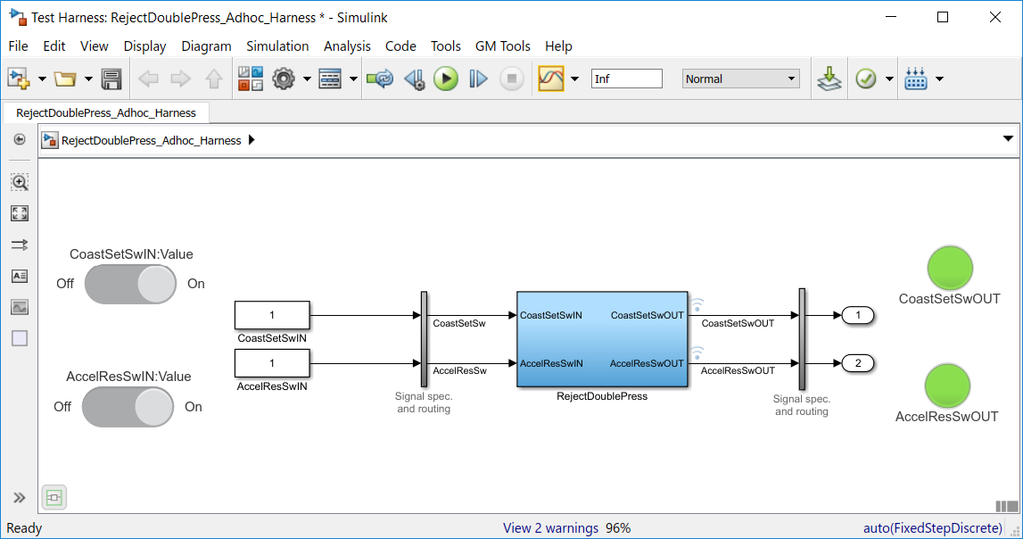
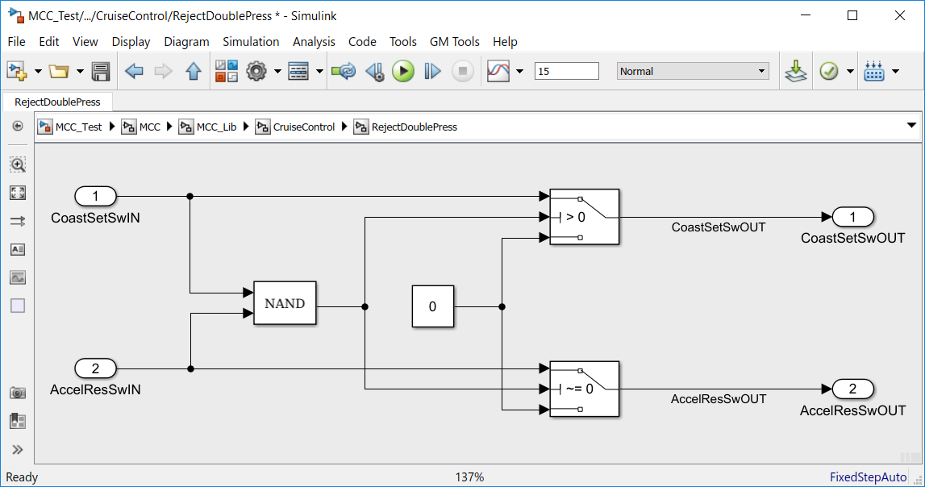
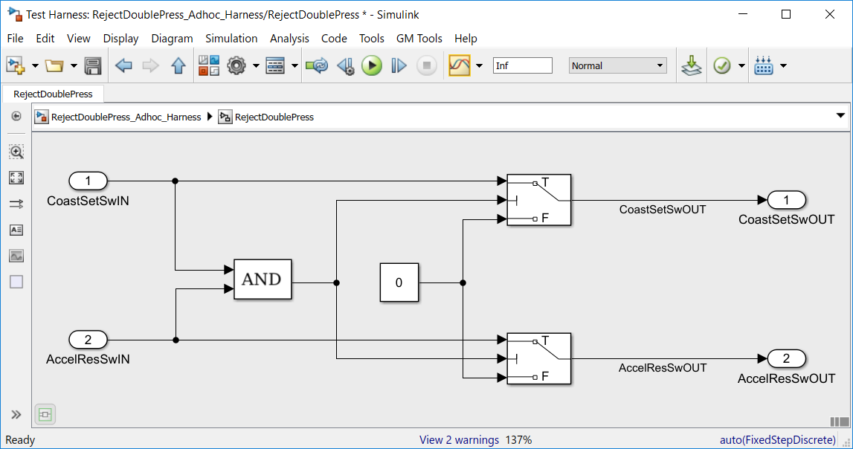
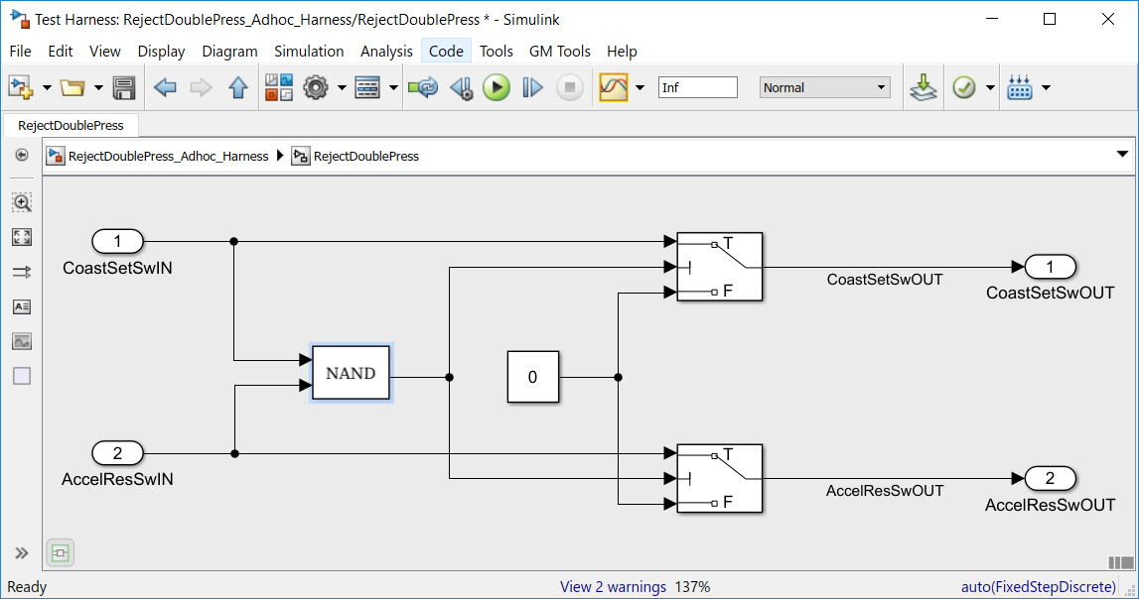
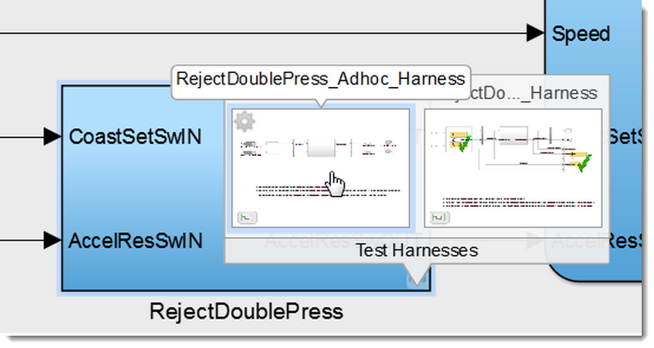
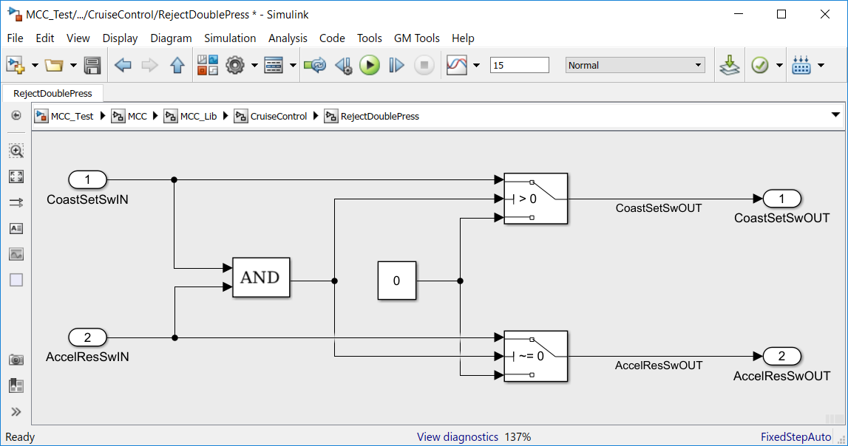
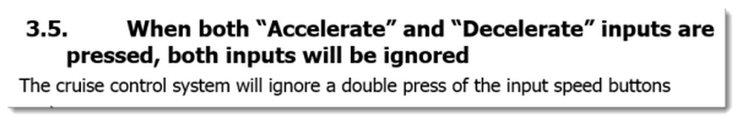
Example Workflow: Subsystem Testing
Use a harness to test the new subsystem
Verify behavior with Dashboard Blocks
Changes in harness synchronized back to component
Simulink Test supports testing of the subsystem feature during development with subsystem harness creation.
Notes:
Range of calibration constraints

Slide 12
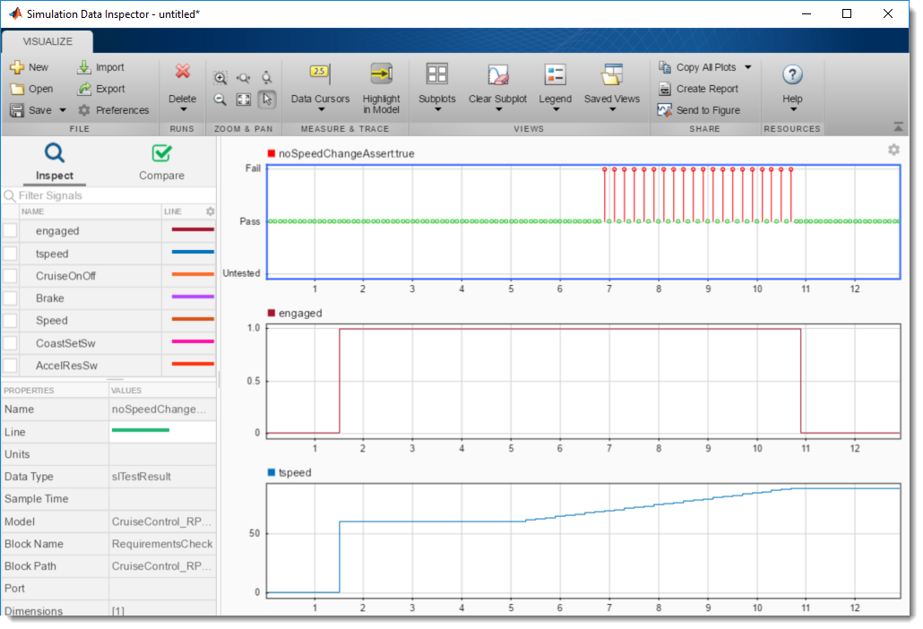
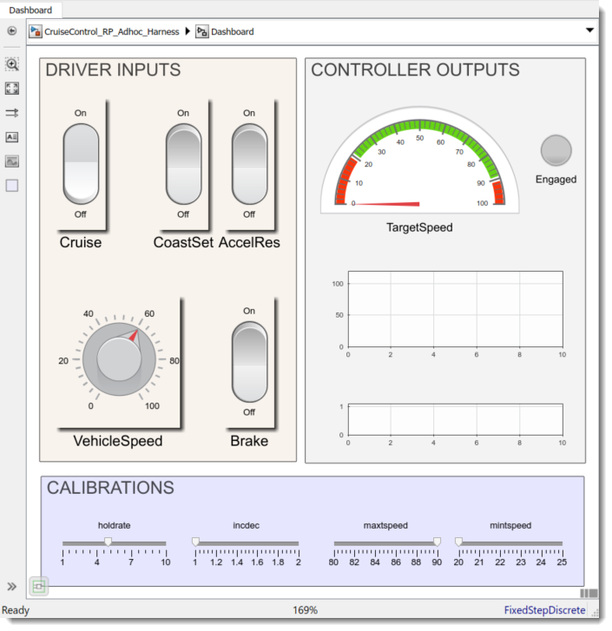
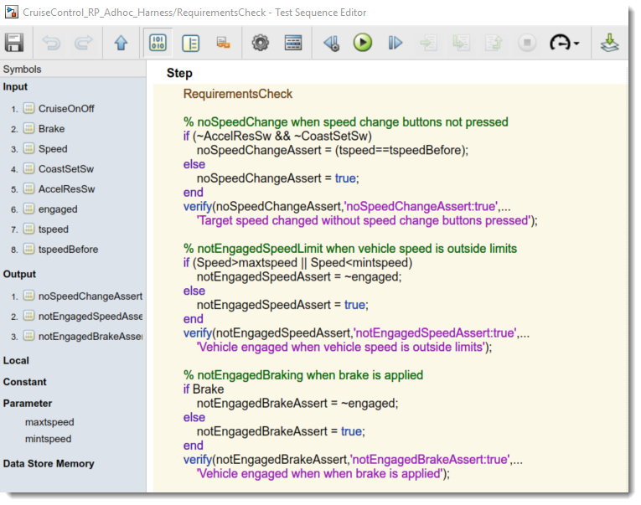
Ad-hoc Testing
Early Ad-hoc Testing with Dashboard Blocks, Verify Signals and Breakpoints
Notes:
Range of calibration constraints

Slide 13
Increasing Confidence beyond Ad-hoc Testing
Ad-hoc testing is a very useful method but what else do we need to check?
Are all requirements implemented?
Does the implementation follow modeling standards?
Have we shown the absence of design errors (dead logic, divide by zero, overflow)?
Does the implementation pass all functional requirements?
Do the tests completely exercise the implementation?
Does the generated code behave the same as the model?
Can we prove the implementation always meets requirements?
Notes:
NEED TO HIGHLIGHT relevant parts of email. Ask question to room …
Shaun: More “feeling”…. Use an email from Chuck (Snagit)… does this happen to you guys ….
Jay: Chuck: Can we start with this…
Use pic of chuck.

Slide 14
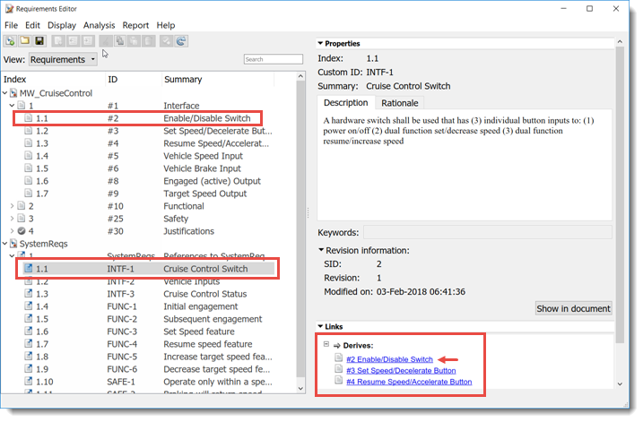
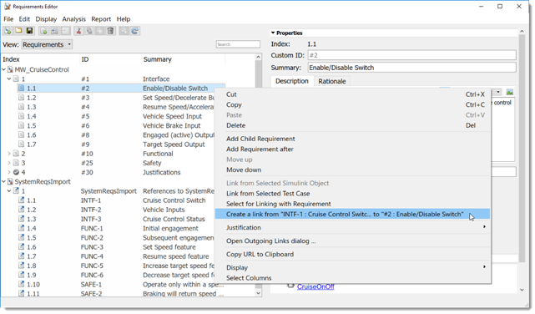
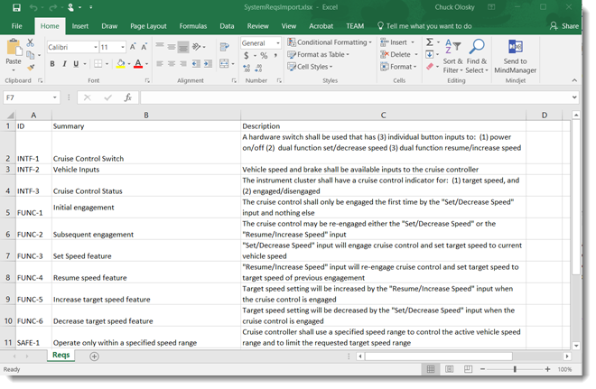
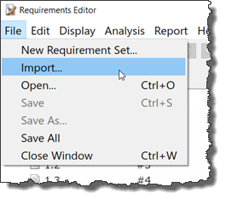
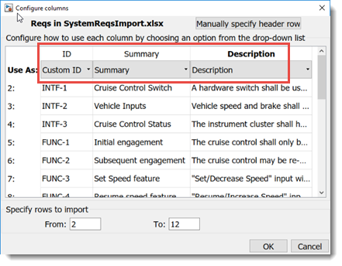
Requirements Editor: Author, Import & Link Requirements
Notes:
Range of calibration constraints

Slide 15
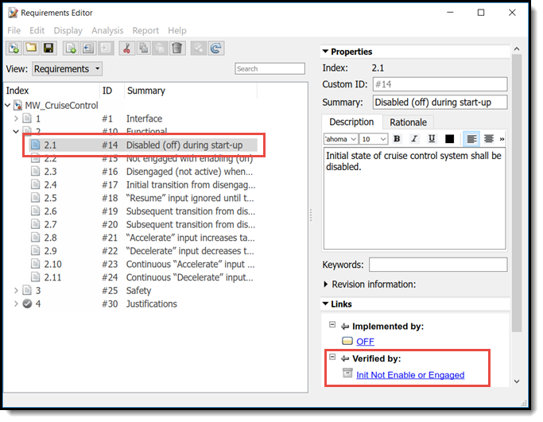
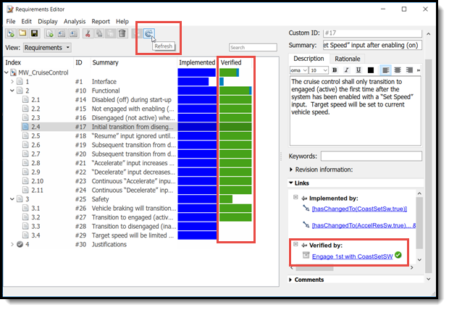
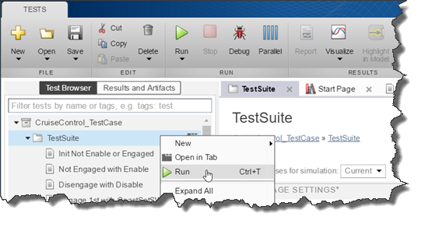
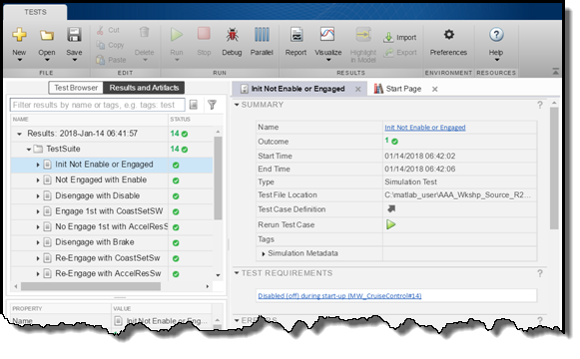
Requirements Editor: Link Types and Status
Notes:
Range of calibration constraints

Slide 16
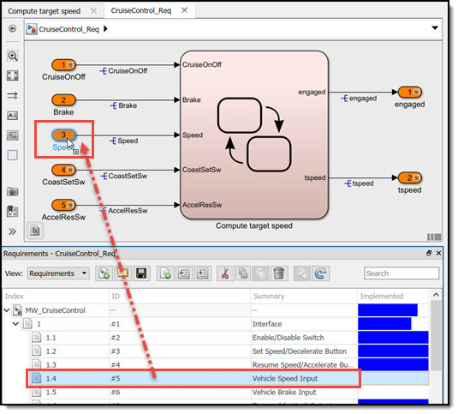
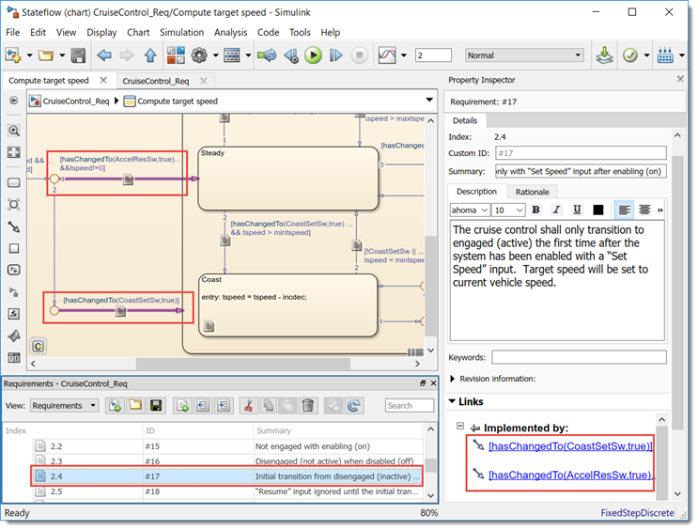
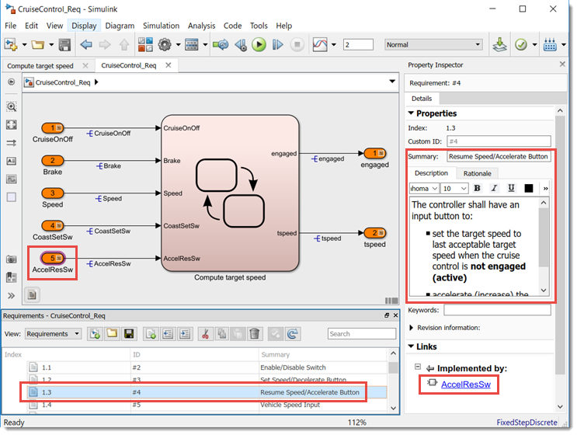
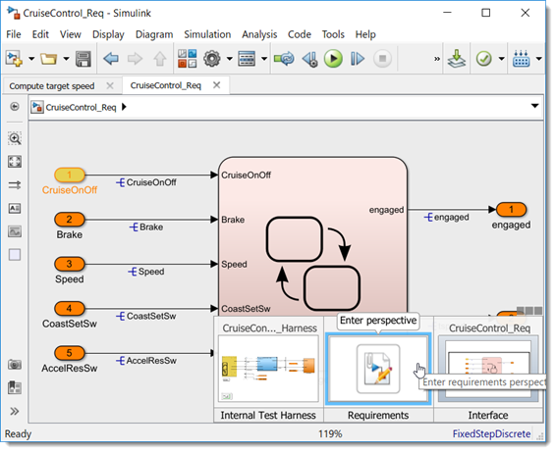
Requirements Perspective: Viewing and Creating Links
Notes:
Range of calibration constraints

Slide 17
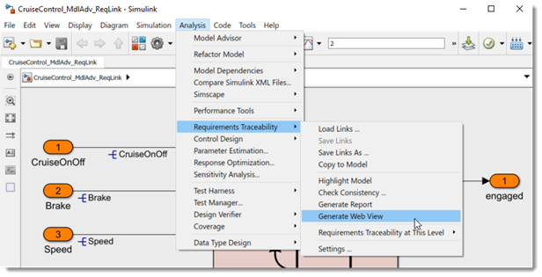
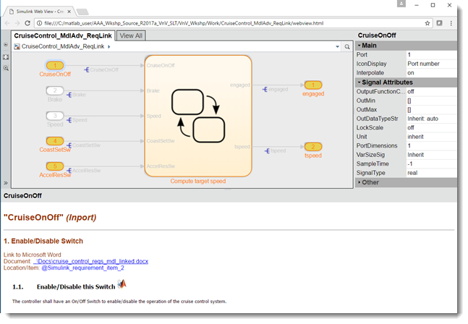
Requirements WebView Report
Notes:
Range of calibration constraints

Slide 18
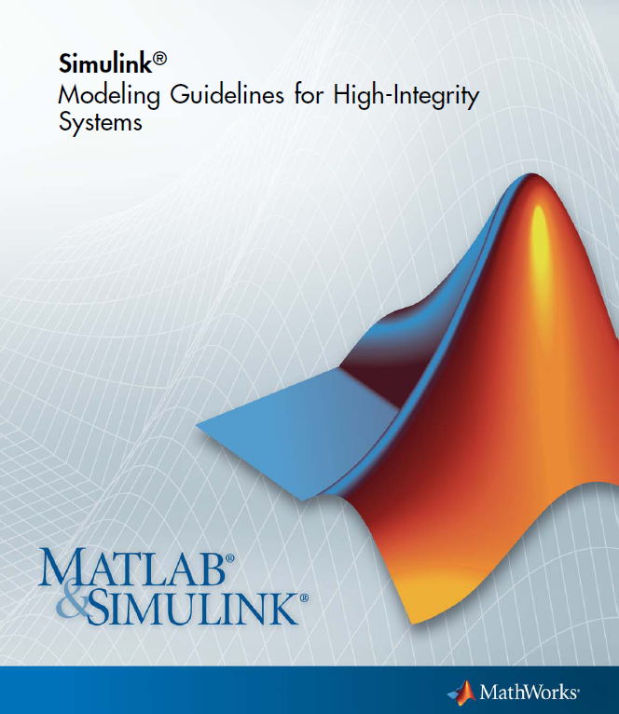
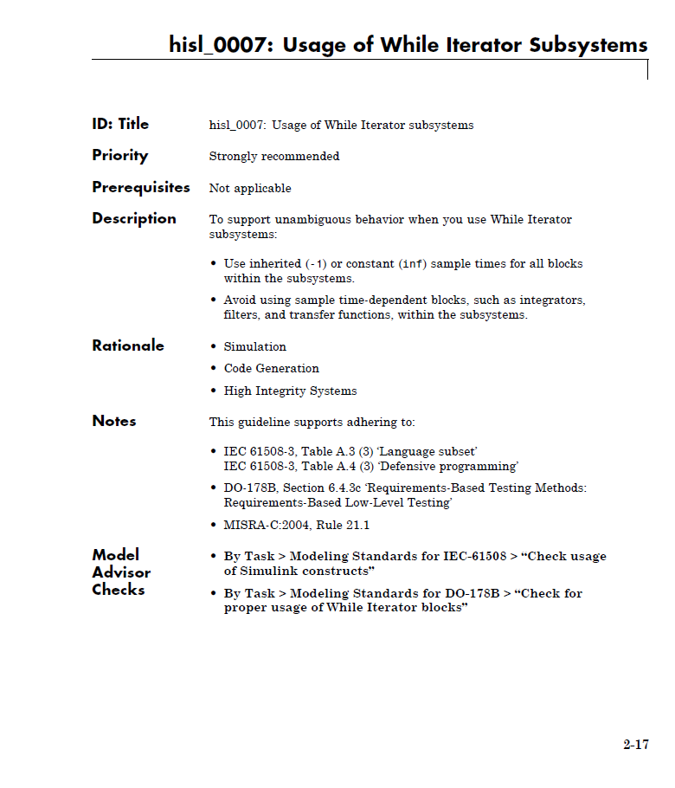
Modeling Guidelines for High-Integrity Systems
Leverage industry-best practices and MathWorks tool expertise when developing high-integrity systems
Modeling Guidelines with corresponding Model Advisor checks
Facilitate modeling standards and guidelines objectives of ISO 26262, IEC 61508, DO-178B, and MISRA-C
http://www.mathworks.com/help/pdf_doc/simulink/hi_guidelines.pdf

Slide 19
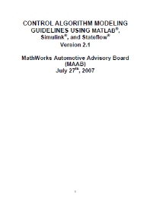
Modeling Guidelines
Modeling Guidelines with corresponding Model Advisor checks
MAAB Style Guides
First version released in April, 2001
Collaboration by industry leaders in US, Japan, Europe: GM, Ford, Chrysler, Toyota, Daimler, John Deere, Delphi, Ricardo and others
Modeling Guidelines for High-Integrity Systems
Leverage industry-best practices and MathWorks tool expertise when developing high-integrity systems
ISO 26262, IEC 61508, DO-178B/C, and MISRA-C

Slide 20
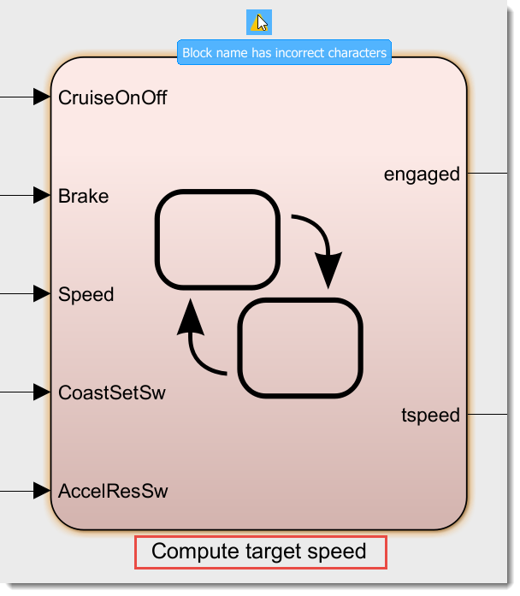

Simulink Check: Edit-Time Model Standards Checking
Notes:
Modeling standards are established either within several industry vendors, or within an organization, or a project. The goal of modeling standards checking is to automate some of the tedious reviews and to prevent problems from being introduced in the model in the first place. An example of a modeling standard is MAAB Style Guidelines document that has just been released in the second major version <link to the homepage if internet connection available)
In a way static checking is a best practice that should be applied on all artifacts you are going to exchange with other development groups, customers, or suppliers, very much like all professional documents and email correspondence should be spellchecked before being sent out.
Simulink Verification and Validation ships with a set of checks that cover a number of MAAB Style Guidelines and as of 2007B also a set of checks for conformance with the DO-178B Guidelines. Also important to mention is the API that allows you to build a set of custom checks and register them with Model Advisor.

Slide 21





Model Advisor – Model Standards Checking
Notes:
Modeling standards are established either within several industry vendors, or within an organization, or a project. The goal of modeling standards checking is to automate some of the tedious reviews and to prevent problems from being introduced in the model in the first place. An example of a modeling standard is MAAB Style Guidelines document that has just been released in the second major version <link to the homepage if internet connection available)
In a way static checking is a best practice that should be applied on all artifacts you are going to exchange with other development groups, customers, or suppliers, very much like all professional documents and email correspondence should be spellchecked before being sent out.
Simulink Verification and Validation ships with a set of checks that cover a number of MAAB Style Guidelines and as of 2007B also a set of checks for conformance with the DO-178B Guidelines. Also important to mention is the API that allows you to build a set of custom checks and register them with Model Advisor.

Slide 22



Simulink Check: Metrics Dashboard
Static analysis of models against a set of checks
Modeling Standards Checks
MAAB Style Guidelines V3.0
ISO 26262
MISRA C:2012
Additional Checks
Model Metrics
Tool Bug Reports (Cert Kit)
Requirements Consistency

Slide 23
Increasing Confidence beyond Ad-hoc Testing
Ad-hoc testing is a very useful method but what else do we need to check?
Are all requirements implemented?
Does the implementation follow modeling standards?
Have we shown the absence of design errors (dead logic, divide by zero, overflow)?
Does the implementation pass all functional requirements?
Do the tests completely exercise the implementation?
Does the generated code behave the same as the model?
Can we prove the implementation always meets requirements?
Notes:
NEED TO HIGHLIGHT relevant parts of email. Ask question to room …
Shaun: More “feeling”…. Use an email from Chuck (Snagit)… does this happen to you guys ….
Jay: Chuck: Can we start with this…
Use pic of chuck.

Slide 24






Simulink Design Verifier – Main Components Uses formal verification
Design Error Detection
Test Generation
Property Proving
Uncover hard to find dead logic and design flaws
Automate test case generation for coverage completion or functional tests
Prove design meets requirements

Slide 25




Finding Design Errors: Dead Logic
Simulink Design Verifier identifies “Dead logic” in model
Notes:
Range of calibration constraints

Slide 26


Finding Unintended Behavior
Converting floating-point model to integer calibrations, signals…
Dead logic due to “uint8” operation
Notes:
Range of calibration constraints

Slide 27

Finding Unintended Behavior
Condition can never be false
Dead logic due to “uint8” operation on incdec/holdrate*10
Fix change the order of operation 10*incdec/holdrate
Notes:
Range of calibration constraints

Slide 28
Increasing Confidence beyond Ad-hoc Testing
Ad-hoc testing is a very useful method but what else do we need to check?
Are all requirements implemented?
Does the implementation follow modeling standards?
Have we shown the absence of design errors (dead logic, divide by zero, overflow)?
Does the implementation pass all functional requirements?
Do the tests completely exercise the implementation?
Does the generated code behave the same as the model?
Can we prove the implementation always meets requirements?
Notes:
NEED TO HIGHLIGHT relevant parts of email. Ask question to room …
Shaun: More “feeling”…. Use an email from Chuck (Snagit)… does this happen to you guys ….
Jay: Chuck: Can we start with this…
Use pic of chuck.

Slide 29
Increasing Confidence beyond Ad-hoc Testing
Ad-hoc testing is a very useful method but what else do we need to check?
Are all requirements implemented?
Does the implementation follow modeling standards?
Have we shown the absence of design errors (dead logic, divide by zero, overflow)?
Does the implementation pass all functional requirements?
Do the tests completely exercise the implementation?
Does the generated code behave the same as the model?
Can we prove the implementation always meets requirements?
Notes:
NEED TO HIGHLIGHT relevant parts of email. Ask question to room …
Shaun: More “feeling”…. Use an email from Chuck (Snagit)… does this happen to you guys ….
Jay: Chuck: Can we start with this…
Use pic of chuck.

Slide 30







Simulink Test Major Features
Test Manager
Author, execute, manage test cases Review, export, report
Test Manager | Test Harness
Author, execute, manage test cases Review, export, report | Synchronized, simulation test environment
Test Manager | Test Harness | Test Sequence Block
Author, execute, manage test cases Review, export, report | Synchronized, simulation test environment | Test Inputs and assessments Based on logical, temporal conditions
Test Harness
Test Harness
Component under test
Component under test
Main Model
Main Model

Slide 31
Simulink Test: Test Harness
Test Harness
Harnesses contained in the model file or externally
Build harness at unit (subsystem) or system level
Synchronized test environment (harness ←→ model)
Enables unit testing without requiring new model
Configure harness input and output blocks
Supports MIL, SIL, PIL or HIL
synchronized
Main Model

Slide 32
Simulink Test: Test Sequence/Assessment Block
Reactive and/or time based test cases
Easier translation of test procedures
Built on top of Stateflow with extensions for testing (SF license not required)
Subset of MATLAB language
Steps are temporal or logic-based
Create complex test inputs and assessments
Supports debugging (breakpoints)

Slide 33

Simulink Test: Test Sequence/Assessment Block Temporal and Event Logic

Slide 34

Simulink Test: Test Sequence/Assessment Block Test Signal Functions

Slide 35
Simulink Test: Test Manager
Create test cases
Group into suites and test files
Execute individual or batch
View result summary
Analyze results
Archive, export, report

Slide 36



Test Manager: Test Case Templates
Simulation Testing
Baseline Testing
Equivalence Testing

Slide 37





Simulation Testing Workflow
Did we meet our requirements?
Review functional behavior
Requirements
Tests
Design
Functional
Did we completely test our model?
Structural
Structural coverage report
Notes:
Requirements mapped to design. Should we mention? Talk about the linking part.
“design testability” … has the design been fully exercised. Coverage.
“measure test completeness” … coverage report.

Slide 38



Model Coverage: What is Model Coverage?
A quick example…
Condition
Decision
MC/DC Coverage:
Each condition independently changes the decision outcome

Slide 39


Did We Completely Test our Model?
Model Coverage Analysis
Potential causes of less than 100% coverage:
Missing requirements
Over-specified design
Design errors
Missing tests
Notes:
Test completeness of the model and execution paths
Data collected during simulation
to be met, can I check that

Slide 40







Requirements Based Functional Testing with Coverage Analysis
All 14 requirements based test cases pass
By analyzing model coverage results we find:
Missing test cases for vehicle speed exit conditions, and
Missing requirements (and test cases) for “hold” or continuous speed button input
Notes:
Range of calibration constraints

Slide 41

Requirements Based Functional Testing with Coverage Analysis
All 14 requirements based test cases pass
By analyzing model coverage results we find:
Missing test cases for vehicle speed exit conditions, and
Missing requirements (and test cases) for “hold” or continuous speed button input
Notes:
Range of calibration constraints

Slide 42












Functional Testing with Added Requirements & Test Cases
Added 2 new requirements for the “hold” case for speed setting input buttons
Added 5 test cases to the original 14 requirements based test cases
3 test cases for the 2 new requirements
2 test cases for the missing test cases for the vehicle speed exist conditions
4/5 new functional test cases pass
Failed test case showed overshoot beyond target speed limits
Coverage analysis highlighted transitions with design errors
Fixed comparison operators, (<) → (<=), and (>) → (>=)
Now all (19) functional test cases pass with 100% model coverage!
Notes:
Range of calibration constraints

Slide 43






Generating Functional Test Cases
Notes:
Range of calibration constraints

Slide 44

Functional Testing with Added Requirements & Test Cases
Notes:
Range of calibration constraints

Slide 45
Increasing Confidence beyond Ad-hoc Testing
Ad-hoc testing is a very useful method but what else do we need to check?
Are all requirements implemented?
Does the implementation follow modeling standards?
Have we shown the absence of design errors (dead logic, divide by zero, overflow)?
Does the implementation pass all functional requirements?
Do the tests completely exercise the implementation?
Does the generated code behave the same as the model?
Can we prove the implementation always meets requirements?
Notes:
NEED TO HIGHLIGHT relevant parts of email. Ask question to room …
Shaun: More “feeling”…. Use an email from Chuck (Snagit)… does this happen to you guys ….
Jay: Chuck: Can we start with this…
Use pic of chuck.

Slide 46
Increasing Confidence beyond Ad-hoc Testing
Ad-hoc testing is a very useful method but what else do we need to check?
Are all requirements implemented?
Does the implementation follow modeling standards?
Have we shown the absence of design errors (dead logic, divide by zero, overflow)?
Does the implementation pass all functional requirements?
Do the tests completely exercise the implementation?
Does the generated code behave the same as the model?
Can we prove the implementation always meets requirements?
Notes:
NEED TO HIGHLIGHT relevant parts of email. Ask question to room …
Shaun: More “feeling”…. Use an email from Chuck (Snagit)… does this happen to you guys ….
Jay: Chuck: Can we start with this…
Use pic of chuck.

Slide 47





Equivalence Testing: Model vs SIL or PIL Mode Testing
Model Coverage→ 100%
Model
Testing
SIL or PIL
Mode Testing
Model to Code
Coverage Comparison

Slide 48






Test Vector Generation for Equivalence Testing: Adding to Requirements Based Test Coverage
Collected coverage for the original 14 requirements based test cases
Created test cases for missing coverage
Ran original plus generated test cases to achieve 100% coverage
Ready for model/code equivalence testing

Slide 49





Code Equivalence Check Results: Model vs Code
Started with 100% model coverage test vectors and test harness
Configured harness component to run in SIL mode
Collected code coverage by executing 100% model coverage test vectors
Verified SIL component outputs match expected functional behavior
Analyzed code coverage differences for possible unintended functionality due to code generation

Slide 50
Increasing Confidence beyond Ad-hoc Testing
Ad-hoc testing is a very useful method but what else do we need to check?
Are all requirements implemented?
Does the implementation follow modeling standards?
Have we shown the absence of design errors (dead logic, divide by zero, overflow)?
Does the implementation pass all functional requirements?
Do the tests completely exercise the implementation?
Does the generated code behave the same as the model?
Can we prove the implementation always meets requirements?
Notes:
NEED TO HIGHLIGHT relevant parts of email. Ask question to room …
Shaun: More “feeling”…. Use an email from Chuck (Snagit)… does this happen to you guys ….
Jay: Chuck: Can we start with this…
Use pic of chuck.

Slide 51
Increasing Confidence beyond Ad-hoc Testing
Ad-hoc testing is a very useful method but what else do we need to check?
Are all requirements implemented?
Does the implementation follow modeling standards?
Have we shown the absence of design errors (dead logic, divide by zero, overflow)?
Does the implementation pass all functional requirements?
Do the tests completely exercise the implementation?
Does the generated code behave the same as the model?
Can we prove the implementation always meets requirements?
Notes:
NEED TO HIGHLIGHT relevant parts of email. Ask question to room …
Shaun: More “feeling”…. Use an email from Chuck (Snagit)… does this happen to you guys ….
Jay: Chuck: Can we start with this…
Use pic of chuck.

Slide 52
Field Test Results: Has something like this happened to you?
From: Larry Findebug Sent: Monday, March 2, 2015 9:29 PM To: Chuck Olosky Subject: Cruise Control Target Speed Issue
I ran into an unexpected issue with the new Cruise Control feature during vehicle testing.
While going downhill, random target speed increases with “reduce speed” button
I set the target speed while going downhill on the track going around 40 mph
While pulsing the “reduce speed” button, target speed reduced to 20 mph limit
Next time I hit “reduce speed”, it increased the target speed from 20 mph to 33 mph
Another time it increased the target speed from 20 mph to 29 mph
Hopefully we can fix this issue quickly. These issues that don’t repeat themselves can be hard to find. Let me know if I can help. ---Larry F
While going downhill, target speed increases with “reduce speed” button

Slide 53
Field Tests Uncover Issue
Problem: While going downhill, target speed increases with “reduce speed” button and assumes random values
Functional tests pass for model
Completely tested the model (100% coverage achieved)
Nominal signal and parameter values worked in simulation
Notes:
Handoff to Chuck at end of slide.
NV: keep abreast of steps.

Slide 54
How can debug the issues found in the field?
Reproduce field issue in Simulink
Use field calibration values
Set inputs manually or replay data if it exists
But this is just “one” more test case that covers a subset of all possible input ranges, sequences and calibration values
Already have requirements based test vectors, 100% coverage, and all passed
How do I know that this will not happen with a different set of conditions?
Road conditions
Driver inputs
Calibration values
Sequence of events
Notes:
NEED TO HIGHLIGHT relevant parts of email. Ask question to room …
Shaun: More “feeling”…. Use an email from Chuck (Snagit)… does this happen to you guys ….
Jay: Chuck: Can we start with this…
Use pic of chuck.

Slide 55

Use Model-Based Design to Reproduce Field Issue…
Construct a model of field issue for Simulink Design Verifier
Constrain inputs to represent field issue
Create model of field issue behavior
Ask tool to prove whether errant condition can occur
Notes:
Add the property fix.
Point to logic that broke.
Then show what you did …
Ask SLDV the following questions:
Can “XXX” ever occur?
Is “XXX” always met by my model?
Do you expect my calibrators to be doing this?

Slide 56

Field Issue Behavior Model Target speed increases with “reduce speed” button
I set the target speed to the vehicle speed (40 mph) while going downhill on the track
I was pulsing the “reduce speed” button until it decreased the target speed to the 20 mph limit
The next time I hit the “reduce speed” button it increased the target speed from 20 mph to 33 mph
Notes:
Identify Failure in Model with Simulink Design Verifier
Are this simply blocks in Simulnk?

Slide 57











Reproducing Field Issues
targetSpeed
targetSpeed
Recreated the field issue
Constrained inputs to match field inputs
Modeled field issue behavior as a property
Property Proving generated a test case that reproduced the field issue
Generated harness was used to debug and demonstrate the fix
CoastSetSw
CoastSetSw
AccelResSw
AccelResSw
Notes:
Range of calibration constraints

Slide 58
















Proving Model will Meet Requirements
targetSpeed
Modeled requirement as a Property model
Unconstrained inputs
Modeled intended requirement behavior
Property Proving generated a test case that violated the requirement
Found unintended behavior when both “speed change” buttons pressed
Added algorithm to reject double press inputs
Proved model now meets this requirement!
targetSpeed
CoastSetSw
CoastSetSw
AccelResSw
AccelResSw
Notes:
Range of calibration constraints

Slide 59



















Proving Model will Meet Requirements over the Calibration Range
targetSpeed
=2
targetSpeed
Added a sweep of possible calibration values to requirement property model
Property Proving generated a test case that violated the requirement
Found unintended behavior with an “incdec” value of (2)
Added a limit check to the speed change algorithm
Proved model now meets this requirement over the range of calibration values!
CoastSetSw
CoastSetSw
AccelResSw
AccelResSw
Notes:
Range of calibration constraints

Slide 60



Re-run Functional Tests after Property Proving Fixes
Partial model coverage for “RejectDoublePress”
Requirements and test cases need to be updated

Slide 61
Verification Design Space: Increasing the Coverage beyond Simulation
SIMULATION TESTING
FORMAL VERIFICATION (Ideal case)
FORMAL VERIFICATION (Real-world)
*
*
*
*
*
*
*
*
*
Design Space
*
*
*
*
*
*
Point coverage of design space through simulation
Verifies correct behavior for these points of the design space
All operating conditions
All input levels and sequences
All possible calibration values
Complete coverage of design space
All possible model behaviors are correct
Real-world application of formal verification
Based on completeness of behavior models
By using formal verification methods…
Simulink Design Verifier proves correct behaviors over a larger amount of the design space
Notes:
Need for formal verification
In order to understand the need for formal verification, lets contrast it to traditional testing methodologies.
In a typical testing framework, we create test inputs to test certain points in our design. These tests could be for functional design points, but in essence we can only hope to test certain (finite) points in the design space. There is a limit to the total design space we can cover in this methods.
In contrast, formal verification lets you achieve 100% coverage of the design space using mathematical techniques – an ideal case. By doing so, we can hope to test a wider part of our design and find flaws and unexpected/unintended parts of our design.
However, note that in practice covering the entire design space may not be feasible – either due to design complexity, nonlinearities, formal engine limitations, time constraints etc. In a practical approach, we do however get much higher confidence (by testing more of the design space) and hence the approach fairs better than traditional point-based testing solutions.

Slide 62
Increasing Confidence beyond Ad-hoc Testing
Ad-hoc testing is a very useful method but what else do we need to check?
Are all requirements implemented?
Does the implementation follow modeling standards?
Have we shown the absence of design errors (dead logic, divide by zero, overflow)?
Does the implementation pass all functional requirements?
Do the tests completely exercise the implementation?
Does the generated code behave the same as the model?
Can we prove the implementation always meets requirements?
Notes:
NEED TO HIGHLIGHT relevant parts of email. Ask question to room …
Shaun: More “feeling”…. Use an email from Chuck (Snagit)… does this happen to you guys ….
Jay: Chuck: Can we start with this…
Use pic of chuck.

Slide 63
Increasing Confidence beyond Ad-hoc Testing
Ad-hoc testing is a very useful method but what else do we need to check?
Are all requirements implemented?
Does the implementation follow modeling standards?
Have we shown the absence of design errors (dead logic, divide by zero, overflow)?
Does the implementation pass all functional requirements?
Do the tests completely exercise the implementation?
Does the generated code behave the same as the model?
Can we prove the implementation always meets requirements?
Notes:
NEED TO HIGHLIGHT relevant parts of email. Ask question to room …
Shaun: More “feeling”…. Use an email from Chuck (Snagit)… does this happen to you guys ….
Jay: Chuck: Can we start with this…
Use pic of chuck.

Slide 64
Gaining Confidence in Your Design
Model/Code Equivalence
Code performs as intended
Requirement Proofs
Prove intended functionality
Design
Confidence
Functional Tests
Pass all functional requirements
Completely tested design
Design Error Check
Detect design errors early
Standards Check
Compliant to modeling standards
Req Linking
All requirements implemented
Ad-Hoc Tests
Find design issues early
Effort / Time

Slide 65
Key Enablers
MathWorks tools enable …
The usage of a standard workflow for software development
A seamless, integrated workflow for model development, code generation and V&V testing
Design verification earlier in the development lifecycle and support across the lifecycle
Increased confidence in the work product with integrated support for code verification

Slide 66
Thank You!

Slide 67
Support

Slide 68
Model Verification Products Timeline
Requirements Mgmt Interface R11.1 (1999)
Model Coverage Tool R12 (2000)
Simulink Requirements R2017b
Simulink Verification and Validation R14 (2004)
Simulink Check R2017b
Simulink Coverage R2017b
Simulink Design Verifier R2007a
2010
2011
2012
2013
2006
2007
2008
2009
1999
2000
2001
2002
2003
2004
2005
2014
2015
2016
2017
Embedded Coder R12 (2000)
IEC Certification Kit R2009a
Simulink Test R2015a
IEC Certification Kit with ISO 26262 R2011a

Slide 69

Documentation
>> doc slvnv

Slide 70

Documentation
>> doc sldv

Slide 71

Documentation
>> doc sltest

Slide 72

Product Page – Simulink Verification & Validation
http://www.mathworks.com/products/simverification/

Slide 73

Product Page – Simulink Design Verifier
http://www.mathworks.com/products/sldesignverifier/

Slide 74

Product Page – Simulink Test
http://http://www.mathworks.com/products/simulink-test//

Slide 75

Solutions Page
http://www.mathworks.com/verification-validation/

Slide 76

MATLAB Central
File Exchange
Download free files
Over 10K available – including functions, apps, examples, and models
MATLAB Answers
Ask programming questions
Search 18K+ existing answers
Cody
Challenge and expand your knowledge of MATLAB
Blogs
Read commentary from MathWorks engineers who design, build, and support MATLAB and Simulink
http://www.mathworks.com/matlabcentral/
Notes:
MATLAB Central is the home of the MathWorks user community, where users can ask and get answers to their questions about MathWorks products. This area of the MathWorks Web site supports idea-sharing and collaboration among users. Resources include a very active file exchange service with over 12,500 user-contributed functions, examples, and other submissions. MATLAB Central also provides convenient Web access to the Usenet newsgroup comp.soft-sys.matlab (affectionately called “CSSM”), where users share ideas, tips and tricks, example code, and viewpoints.
MATLAB Central:
averaging 200 submissions per month
380,000 downloads per month
MATLAB Answers
Search for and rate answers to programming questions in a collaborative question and answer environment
averaging 120 new questions and 685 new answers posted every day
Comment on, contribute, or vote up answers, building reputation as you go
For more information, refer to mathworks.com/matlabcentral.

Slide 77


http://www.mathworks.com/services/training/courses/
Notes:
The MathWorks Training Services helps you use our products to succeed in your work. Our training courses are developed around the core responsibilities of engineers, scientists and educators like you. Our trainers focus on your goals and how to utilize MathWorks tools to achieve them.
Public Instructor-led Training Public instructor-led courses are offered in North America, France, Germany, Italy, Spain, Switzerland, the Netherlands and the United Kingdom. In addition, many of our distributors offer training at other international sites. So, whether you are in Boston, München , or Bangalore, you can find hands-on training at a location near you.
On-Site Instructor-led Training
The MathWorks also offers customized training courses that can be taught at your own facility. Our engineers can incorporate company- or industry-specific examples into a curriculum of your choosing.
Instructor-led E-Learning All of our training courses (except for a few that require specialized hardware) are also offered over the Web. An instructor in one of our offices can share their desktop with you and communicate over the phone. You get the same high quality instruction, but in the convenience of your home or office. Our e-learning courses are also typically run with far fewer students, with a more flexible schedule.
Course Topics
The MathWorks offers introductory and intermediate courses in MATLAB, Simulink and Stateflow, as well as advanced courses in subjects such as control design, signal and image processing, test and measurement, optimization, statistics and financial analysis.
For course information and the latest training schedule and locations:
www.mathworks.com/training

Slide 78
Consulting Process Related Services by Stage of Adoption
Consulting advisory services is
customizable based on customer requirements
Customer Profile:
Has established Model-Based Design for production project
Production usage of code generation
Some level of formalized verification workflow
Wants to update to an ISO compliant process
Process and Technology Standardization
Customer Profile:
Use MBD for algorithm development & rapid prototyping
Use traditional hand code method
No formalized verification workflow (with model)
Wants to transition to Model-Based Design development workflow
Model-Based Design Maturity
Process Deployment Advisory Services including ISO 26262
Expanded Rollout
Target Specific Process Establishment Advisory Services
Department Rollout
Project Rollout
Initial Adoption
Explore
Expand
Standardize

